Slide 1
Microsoft Innovation Challenge March 2026
Copilot CLR
Cognitive Load Reduction Copilot
AI Accessibility Assistant for Neurodiverse Users
Presented by:
Cristopher Hugo Olivares Del Real
Jonathan Salvador Herrera Navarro

Slide 2
The Challenge
Daily Pain Points
15–20%
of the global population
is neurodiverse
Complex, multi-step task instructions
Dense, unstructured documents
Standard AI assistants not designed for their needs
The Gap in AI Today
Current AI produces verbose, unpredictable responses
Responses can be anxiety-inducing for neurodiverse users
Azure tools existed — but had never been assembled into a focused, adaptive experience
Including individuals with:
ADHD · Autism · Dyslexia

Slide 3
Why We Chose This Challenge
We believe accessibility is not an edge case — it is a core requirement.
Growing Priority
Market Gap
Workplace & educational neurodiversity is an increasing focus across industries worldwide.
No mainstream AI assistant currently offers purpose-built accessibility modes for neurodiverse users.
Azure Opportunity
Measurable Impact
We saw the chance to combine 17 Azure services into one coherent, human-centered product.
Faster task completion, lower cognitive load, and higher independence — all quantifiable outcomes.

Slide 4
Our Solution
Copilot CLR
Step Decomposition
Breaks complex instructions into numbered, time-boxed steps
An AI-powered accessibility assistant that transforms complex information into clear, structured, and personalized formats — built for neurodiverse users.
Reading Levels
Simplifies documents from Grade 2 to Grade 12
17 Azure Services · Zero Secrets · Responsible AI
Neural Voice TTS
Reads responses aloud with calm, measured neural voices
User Preferences
Adapts font, contrast, pace, and format per user
Real-Time Voice
Full-duplex AI voice conversation support
Responsible AI
Calm, supportive language enforced by Azure Content Safety

Slide 5
Why We Built With Fluent UI
Familiarity Reduces Load
Fluent UI is Microsoft's design system
Users already know Fluent patterns from Teams and Office.
The same design language used across Teams, Office, and Windows — familiar to millions.
Accessibility First
"For neurodiverse users, familiarity is not a luxury — it reduces cognitive load."
Built-in screen reader support, keyboard nav, and high-contrast modes.
Atomic CSS via Griffel
Lightweight, fast UI that never sacrifices performance.
Predictable Components
Consistent, low-noise components reduce anxiety.
Full Theming
Color overlays, dyslexia-friendly fonts, and reduced-motion modes.

Slide 6
Why We Used the Microsoft Agent Framework
Microsoft Agent Framework (MAF)
Single SDK
Enterprise stability + cutting-edge multi-agent orchestration in one package.
The unified successor to Semantic Kernel and AutoGen — combining enterprise stability with cutting-edge multi-agent orchestration.
PromptAgentDefinition
Deploy specialized agents with distinct personas and tools.
Three Specialized Agents:
Task Decomposer
Speech Assistant
Content Adapter
Azure AI Foundry
Native integration with AI Foundry Agent Service.
Tool Binding
Azure AI Search, Cosmos DB, and Service Bus — zero glue code.
Voice Live SDK
Connects agents directly to real-time voice sessions.
Built-in Telemetry
OpenTelemetry + Application Insights out of the box.

Slide 7




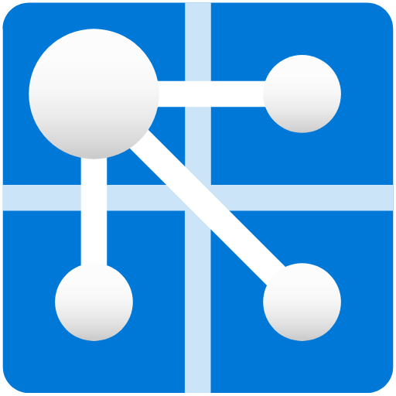

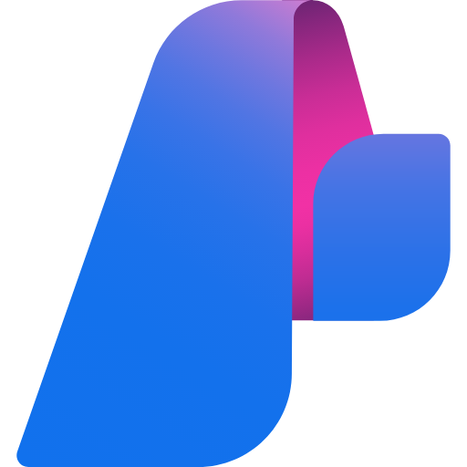


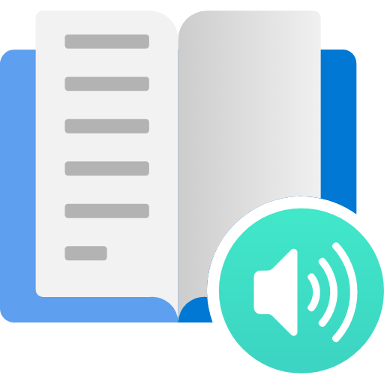



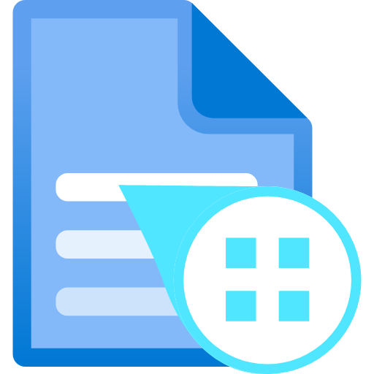
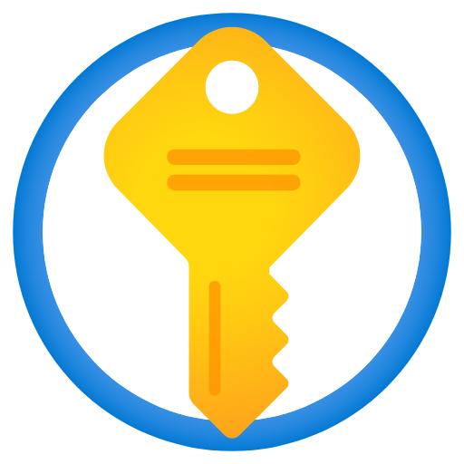

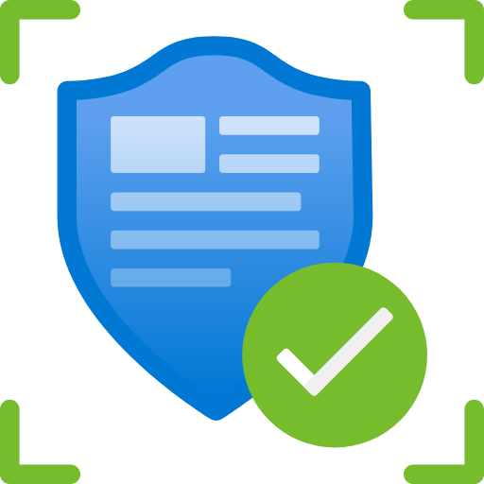

Powered by 17 Azure Services
AI & Agents
Accessibility
Real-Time Voice
Data & Storage
Compute & Ops
Azure OpenAI
AI Foundry Hub
Azure AI Search
Content Safety
Speech Service
Immersive Reader
Document Intelligence
Azure Web PubSub
Voice Live SDK
Cosmos DB
Blob Storage
Azure Key Vault
Container Apps
Container Registry
Static Web Apps
Service Bus
Azure Monitor
Zero-secret architecture — all services connected via Managed Identity and RBAC.

Slide 8
Built With Responsible AI at the Core
All six Microsoft RAI principles implemented in code — not just documentation.
Fairness
Safety
Privacy
Users set their own reading level — no assumptions about capability.
Azure Content Safety screens every input and output across text, speech, and voice.
Zero secrets in code; all data isolated by user partition key.
Inclusiveness
Transparency
Accountability
TTS, Immersive Reader, dyslexia fonts, color overlays, and focus timers.
Every AI response carries an 'AI-Generated' badge — always visible.
Every response has a Report button; flagged content stored for human review.

Slide 9
Cognitive Load Reduction Copilot
Reducing cognitive load for neurodiverse users — one clear step at a time.
17
Azure Services
6
RAI Principles
3
AI Agents
∞
Accessibility
Built on Azure AI Foundry · Microsoft Agent Framework · Fluent UI · Zero Secrets · Responsible AI

